Slide 1
Topic: Ratios EQ: How to use ratios for a scale?
Year 11 Essentials

Slide 2
Things Required For This Lesson
Interactive Notebook
Textbook: Interleaved Maths Essential Connections
Ruler, Red Pen, Pencil, Pens, Scientific Calculator
Growth mindset

Slide 3

24
7
30
Topic: Rates
Date: /03/2021
EQ: How are rates used for different units of measurement?
WICOR

Slide 4
Topic: Rates
Pg. 136
EQ: How are rates used for different units of measurement?
Interleaved Questions
leave at 8:55am and travel for 3.2 hours. When do I arrive?
Perth Temperature data, 1994-2020 is provided in the table below. What was the mean minimum temperature across the whole year.?
 | Jan | Feb | Mar | April | May | June | July | Aug | Sept | Oct | Nov | Dec
Mean Max Temp | 31.2 | 31.6 | 29.6 | 25.9 | 22.3 | 19.5 | 18.4 | 19.1 | 20.4 | 23.4 | 26.8 | 29.3
Mean Min Temp | 18.1 | 18.4 | 16.8 | 13.8 | 10.4 | 8.6 | 7.9 | 8.3 | 9.5 | 11.6 | 14.4 | 16.4

Slide 5
Topic: Rates
Pg. 136
EQ: How are rates used for different units of measurement?
Interleaved Questions
leave at 8:55am and travel for 3.2 hours. When do I arrive?
Perth Temperature data, 1994-2020 is provided in the table below. What was the mean minimum temperature across the whole year.?
12:07pm
12.85
 | Jan | Feb | Mar | April | May | June | July | Aug | Sept | Oct | Nov | Dec
Mean Max Temp | 31.2 | 31.6 | 29.6 | 25.9 | 22.3 | 19.5 | 18.4 | 19.1 | 20.4 | 23.4 | 26.8 | 29.3
Mean Min Temp | 18.1 | 18.4 | 16.8 | 13.8 | 10.4 | 8.6 | 7.9 | 8.3 | 9.5 | 11.6 | 14.4 | 16.4

Slide 6
24
7
30
Topic: Rates
EQ: How are rates used for different units of measurement?
What are rates?
Rates compare different units of measurement.
For Example: A student typed 80 words in 2 minutes.
We usually express rates as “per one” of a measuring unit.
For Example: This means that the typing speed would be described in “words per minute” rather than words per two minutes.
Therefore: The students typing speed was 40 words per minute or 40wpm
WICOR

Slide 7
Think pair share
What are some commonly used rates?
Car Speed: km per hour (kmph or km/h)
Pay rates, penalty rates and charge out rates: $ per hour.
Phones Charges: $ per minute
Motor speed: Revolutions per minute (rpm)

Slide 8
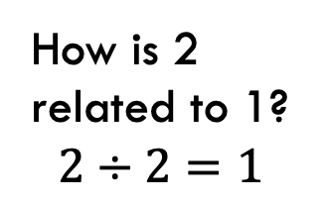


24
7
30
Topic: Rates
EQ: How are rates used for different units of measurement?
How to find the “per one”
1. A car travelled 120km in 2 hours. Write the cars speed in km/h.
Relationship Table:
How is 2 related to 1?
$$2÷2=1$$
What you do to one number, you need to do to the other.
$$120÷2=60$$
km | h
120 | 2
 | 1
$$÷2$$
60
= The cars was travelling at 60km/h
WICOR

Slide 9
Practice: (LSH)
Task
Complete the Experiment, Explore and Evaluate section on page 35
Complete the Explore and Apply questions on Page 36

Slide 10
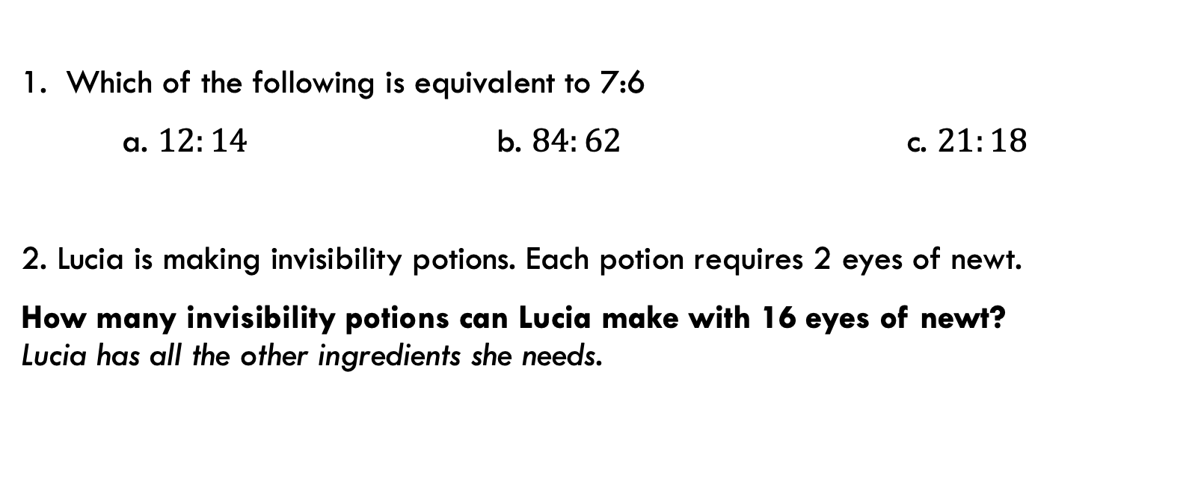
Exit Pass
1. Which of the following is equivalent to 7:6
a. $12:14$ b. $84:62$ c. $21:18$
2. Lucia is making invisibility potions. Each potion requires 2 eyes of newt.
How many invisibility potions can Lucia make with 16 eyes of newt? Lucia has all the other ingredients she needs.

Slide 11

Thank you
Keep up the good work!
“You are braver than you believe, stronger than you seem and smarter than you think.”
-A.A Milne

